Slide 1
HF-based wet etch tests
Etch rates on four different HF-based etchant was measured on SiOx (recipe: OXIDE_100nm_300C) and SiN-H2 free films (recipe: SiN_No_NH3_100nm_300C).
Etching performed on wafers supplied by LNL on 2025-10-13.
A low etch rate of only 0.02 nm/s (1.2 nm/min) in BOE (10:1) observed for the SiN film. This etch rate is unexpectedly low and more in line what would be expected by and LPCVD film.
A much higher BOE (10:1) etch rate observed for SiOx of 2.7 nm/s (160 nm/min), resulting in a selectivity to SiN of 138. This SiOx etch rate is reasonable based on numbers provided in literature and about half that of ALD-SiOx deposited using the Fiji tool.
Material | Etchant | Etch rate (nm/s)
SiOx | BOE (10:1) | 2.7E+00
SiOx | HF (3:100) | 1.7E+00
SiOx | HF (1:100) | 3.7E-01
SiOx | HF (1:1000) | 2.8E-02
SiNx - H2 free | BOE (10:1) | 2.0E-02
SiNx - H2 free | HF (3:100) | 2.3E-02
SiNx - H2 free | HF (1:100) | 8.2E-03
SiNx - H2 free | HF (1:1000) | 1.0E-03

Slide 2
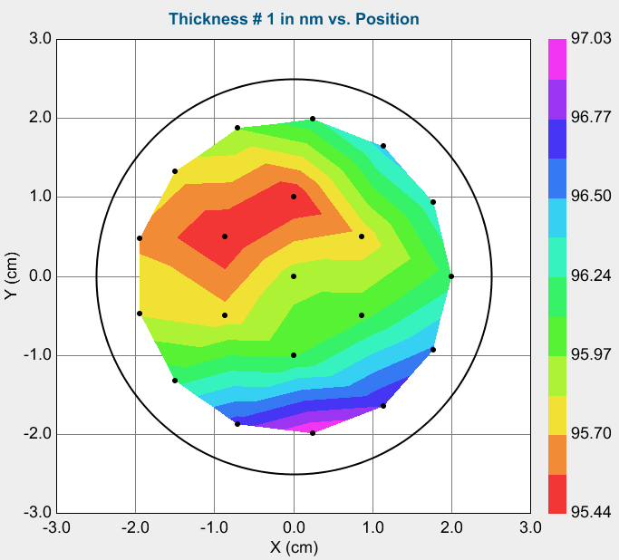
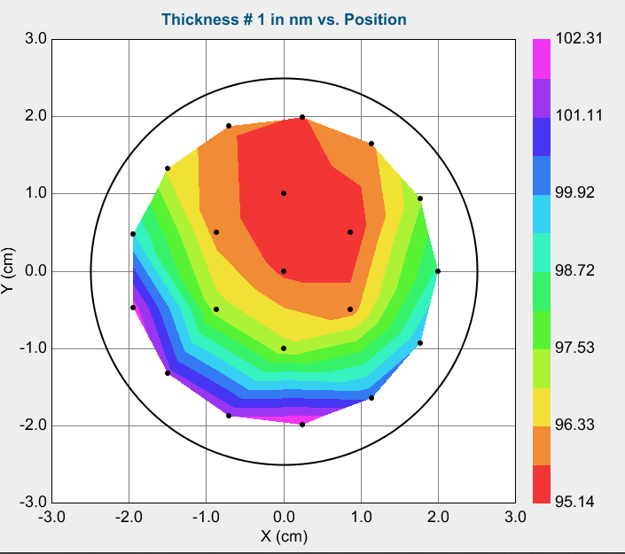
P251020_SPTS
P251020_SPTS_1
  Recipe: OXIDE_100nm_300C
  Samples:
    Fused Silica 2" wafer from WUS20500250XXXXXSNN1
    n-Si 2'' wafer
    Pyramid chip (E250424B_W1_R4C4)
    GaN-on-sapphire planar piece (cleaved from one X-60WJOB24040770-4 wafer)
  Ellipsometry
    Thickness: 96.24 nm
    n: 1.49
P251020_SPTS_2
  Recipe: SiN_No_NH3_100nm_300C
  Samples:
    Fused Silica 2" wafer from WUS20500250XXXXXSNN1
    n-Si 2'' wafer
    Pyramid chip (E250424B_W1_R4C3)
    GaN-on-sapphire planar piece(cleaved from one X-60WJOB24040770-4 wafer)
  Ellipsometry
    Thickness: 98.72 nm
    n: 2.02
Thickness non-uniformity seem much larger than what was observed on 200 mm wafers. The placement of wafers/chips on carrier wafer probably impacts gas flows or plasma densities, resulting in varying thicknesses.
P251020_SPTS_1
P251020_SPTS_2

Slide 3
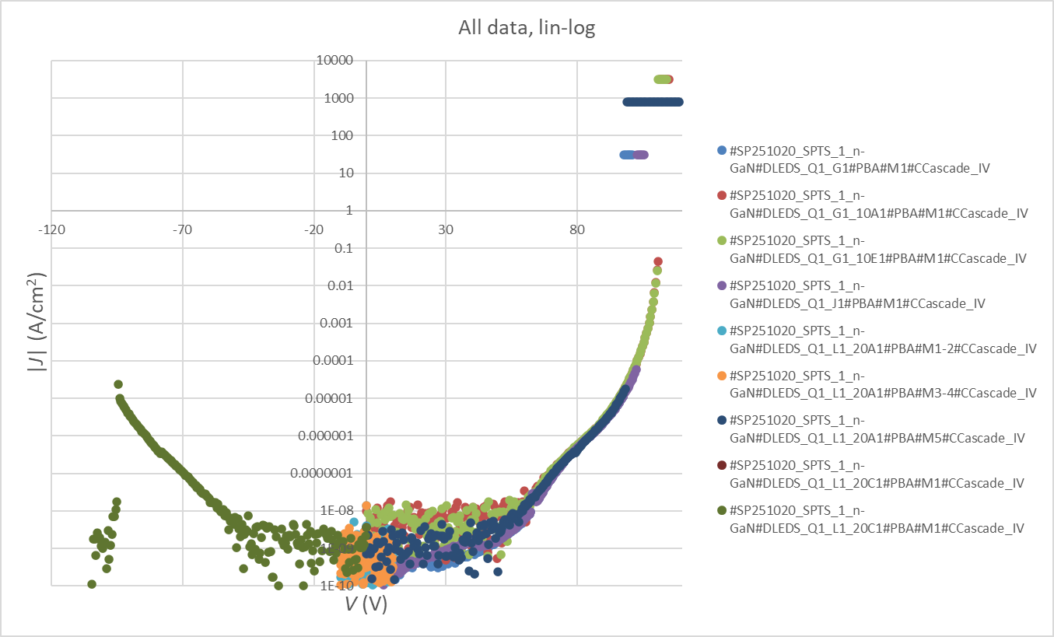
P251020_SPTS_1 (SiOx)
Device | Breakdown voltage (V) | Breakdown field (MV/cm) | Anode area (µm²)
LEDS_Q1_G1 | 98 | 10.2 | 32668
LEDS_Q1_J1 | 103 | 10.7 | 32668
LEDS_Q1_L1_20A1 | 99 | 10.3 | 1257
LEDS_Q1_G1_10E1 | 111 | 11.5 | 314
LEDS_Q1_G1_10A1 | 111.5 | 11.6 | 314
LEDS_Q1_L1_20C1 | -94.5 | -9.8 | 1257
MLA lithography on LOR/S1805 resist stack followed by lift-off of 10 nm Ti + 200 nm contacts performed on pyramid chip.
Metal contacts fabricated on top of SiO₂ film (anodes) and on large areas where scribing was performed down to n-GaN layer (cathodes).
  Average resistance between cathodes about 49 Ω.
Only planar n-GaN-on-sapphire sample measured electrically.
Three different anode sizes measured (314 µm², 1257 µm², 32668 µm²), two of each size.
Very similar J(V) characteristics between all devices and sizes.
  Exclusively vertical current through the SiO₂-film.
Average breakdown electric field of 10.7 mV/cm.

Slide 4
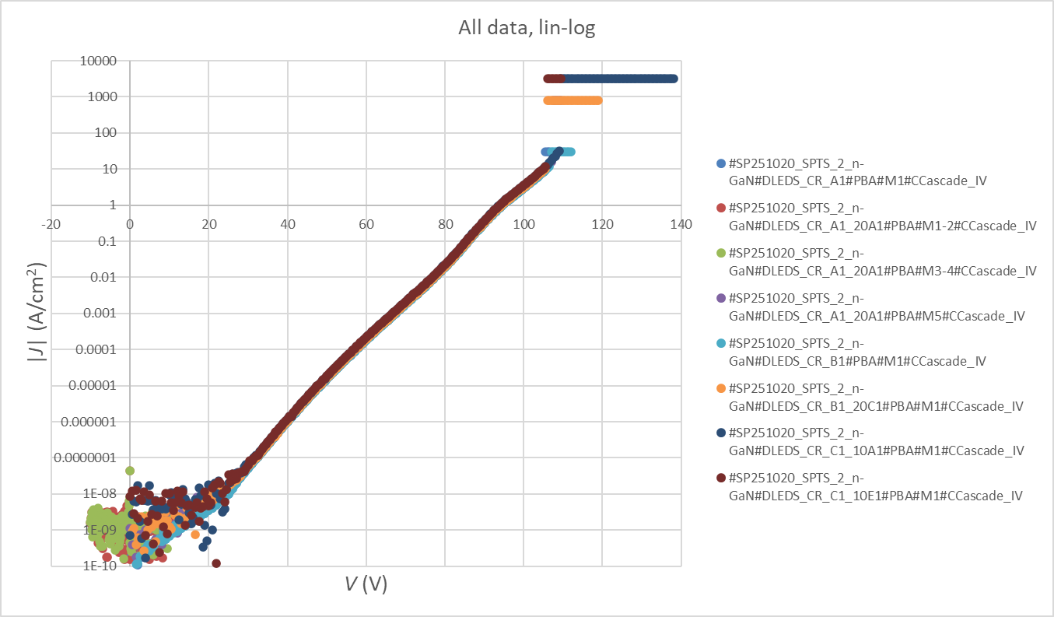
P251020_SPTS_1 (SiN)
MLA lithography on LOR/S1805 resist stack followed by lift-off of 10 nm Ti + 200 nm contacts performed on pyramid chip.
Metal contacts fabricated on top of SiN film (anodes) and on large areas where scribing was performed down to n-GaN layer (cathodes).
  Average resistance between cathodes about 65 Ω.
Only planar n-GaN-on-sapphire sample measured electrically.
Three different anode sizes measured (314 µm², 1257 µm², 32668 µm²), two of each size.
Very similar J(V) characteristics between all devices and sizes.
  Exclusively vertical current through the SiN-film.
Average breakdown electric field of 11.1 mV/cm.
Device | Breakdown voltage (V) | Breakdown field (MV/cm) | Anode area (µm²)
LEDS_CR_B1_20C1 | 106 | 11.0 | 1257
LEDS_CR_A1_20A1 | 107.5 | 11.2 | 1257
LEDS_CR_C1_10E1 | 106 | 11.0 | 314
LEDS_CR_C1_10A1 | 109.5 | 11.4 | 314
LEDS_CR_A1 | 105.5 | 11.0 | 32668
LEDS_CR_B1 | 107 | 11.1 | 32668

